Slide 1
E-commerce Product delivery Prediction
From :- Sai Deepak Sonawane.

Slide 2

Agenda
Project Objective
Dataset Overview
Data Preprocessing
Exploratory Data Analysis
Correlation Analysis
Model Evaluation
Conclusion

Slide 3
Project Overview
Objective:
This project aims to enhance the understanding of product delivery patterns and customer behavior for an international e-commerce company specializing in electronic products.
The project focuses on predicting whether products will reach customers on time using machine learning models.
Understand key factors influencing delivery times (e.g., product properties, customer behavior).

Slide 4
End to end Deployment Flow:
Data Set
Data collection
Exploration&
Feature engineering
Data Model Selection & training
Evaluation of Model & Optimization
Model Deployment
User

Slide 5
Dataset Summary:-
Dataset Summary:-
1. Total records: 10,999 rows.
2. Features: 12 columns including:
Warehouse_block, Mode_of_Shipment, Customer care calls, Cost of the Product, Weight_in_gms, and Reached.on.Time_Y.N
=Target Variable:- Reached.on.Time_Y.N ( 1: On Time, 0:Delayed)
Key Attributes:-
1.Warehouse_block:- Source of Shipment(A to Z)
2.Mode_of_Shipment:- Transport method ( Ship ,Flight ,road )
3.Discount_offered:- Promotional discounts.
4.Product_importance: Importance level (Low , Medium, High )

Slide 6
Data Preprocessing :-
Steps followed :-
Checked for missing values: No missing data was found
Converted categorical variables to numerical using encoding (e.g., one-hot encoding for Gender, Warehouse_block)
Normalized numerical features (e.g., Cost of the Product, Weight in gms)
Split data into training (80%) and testing (20%) sets for model building

Slide 7
Exploratory Data Analysis :-
Gender Distribution :-
Nearly equal representation of male and female customers(~50% each)
Product Insights : -
Heavier products (2500-3500 granıs) are more likely delivered on time
Products costing below $250 are more punctual compared to higher-cost items.
Customer Behavior :-
High customer care calls often indicate delayed delivery
Repeat customers have better delivery outcomes
Discount Impact :-
Minimal discounts (0-10%) lead to more late deliveries
Higher discounts (>10%) correlate with timely deliveries

Slide 8
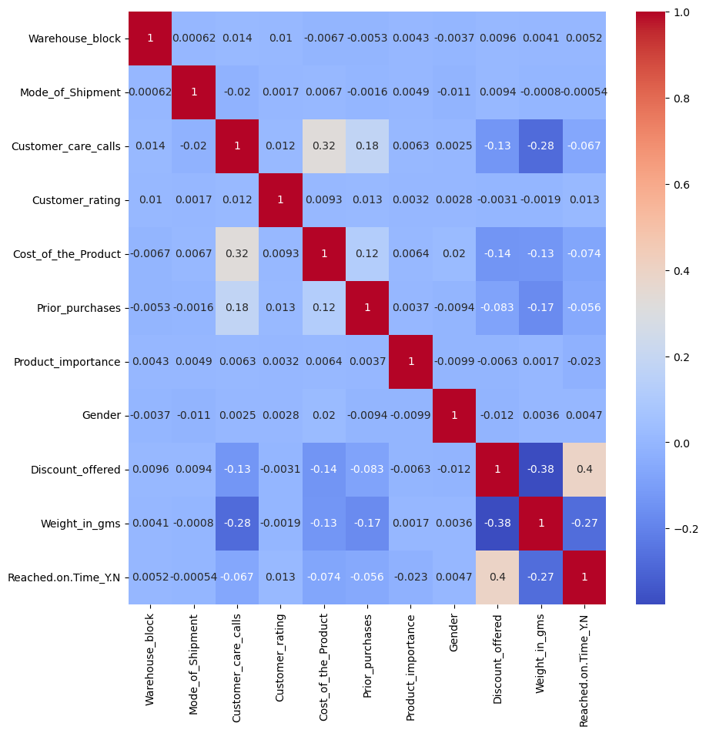
Correlation Heatmap Observation :-
Positive Correlation :-
Product cost ←→ Customer care calls
(indicating customer concerns
for high-value items ).
Negative Correlation :-
Discounts ←→ Delivery delays
(higher discount improves
punctuality).

Slide 9
-:Machine Learning Models :-
Model Used :--
Ⅰ. Decision Tree Classifier:
Selected optimal parameters via grid search
Best depth :8 , minimum sample split: 2.
Ⅱ. Random Forest Classifier:
Explored ensemble learning for improved accuracy.
Ⅲ. Logistic Regression:
Interpreted linear relationships between features
Ⅳ. K-Nearest Neighbors :
Examined proximity-based decision-making.
Train-Test Split:
Training accuracy varied from 63% to 78%.
Test accuracy ranged between 63% and 69%.

Slide 10
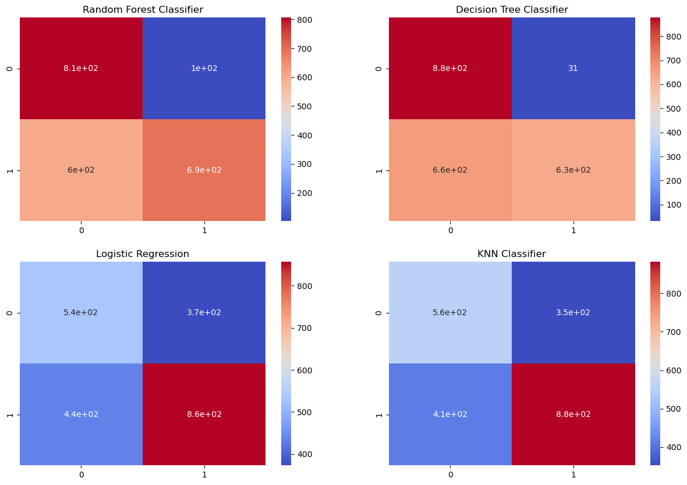
-:Model Evaluation:-

Slide 11
-:Model Performance:-
Performance Summary:
1.Decision Tree Classifier: Highest Test accuracy at 69%.
2.Random Forest: Close second with 68% accuracy.
3.Logistic Regression: Moderate performance at 63%
4.K-Nearest Neighbors: Lowest test accuracy at 65%
Metrics Used:
1. Precision: Model’s ability to predict on-time deliveries correctly.
2. Recall: Sensitivity to capture all true positives.
3.F1-Score: Balance between precision and recall

Slide 12
-:Key Findings:-
Insights from EDA and Modeling :-
Product Factors :
1. Products between 2500-3500 grams delivered on time more often.
2. High-value products ($250+) experienced delays
Warehouse Logistics :
1. Warehouse F processed a majority of on-time deliveries, likely due to seaport proximity
Customer Behavior :
1. Frequent customer care calls indicate delivery issues
2. Repeat customer benefited from more reliable deliveries
Discounts :
Offers >10% improved delivery punctuality

Slide 13
-:Conclusion:-
The project's objective was to forecast on-time delivery for an e-commerce company's products and to explore factors influencing delivery times and customer behavior. The exploratory analysis highlighted that product weight and cost are crucial to delivery success, with products in the 2500 – 3500 gram range and priced under $250 being more likely to arrive on time. A significant volume of products was dispatched from warehouse F using shipping, suggesting its proximity to a seaport
Customer behavior also sheds light on delivery outcomes. An increase in customer care calls often correlates with delivery delays. In contrast, customers with a history of multiple purchases tend to experience more punctual deliveries, which might explain their repeat business. As for discounts, products with minimal discounts (0-10%) saw more late deliveries, while those with discounts exceeding 10% were more often delivered on time
Regarding machine learning models, the decision tree classifier outperformed others with a 69% accuracy rate. Close behind were the random forest classifier and logistic regression, with 68% and 63% accuracy, respectively. The K Nearest Neighbors model trailed with the least accuracy at 65%

Slide 14
Recommendations:-
Optimize shipping routes for heavy products.
Enhance operations at high-performing warehouses (c.g., F).
Investigate and address customer care interactions to mitigate delays.

Slide 15
Questions ?

Slide 16
Thank You!

